Slide 1


Slide 2
ChaProEV availability
Source code
Library
https://github.com/TNO/ChaProEV
https://pypi.org/project/ChaProEV/
Understand how the model works
Add scenario files and call functions within your model or independently

Slide 3
Running ChaProEV
Theme name
Place text here
Case study
Country characteristics
Urbanisation/ population density types
Map these to NUTS via population density
Can swap in a more detailed model if available/desired
Can swap in a more detailed model if available/desired
Scenario
Vehicle
Location
Legs
Trips
Calendar
Mobility matrix
Amounts of departures/arrivals
(Weighted) distances
Durations
Consumption
Per hour, day, week, month, year
Per energy carrier
Charging
Per vehicle/from network
Per location
Per hour, day, week, month, year

Slide 4
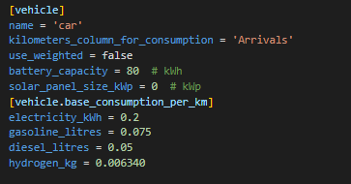
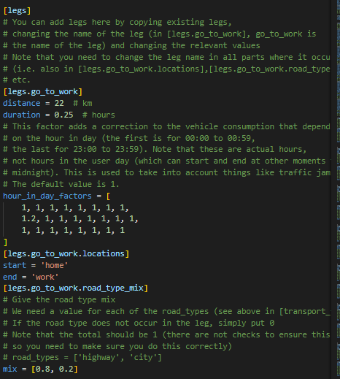
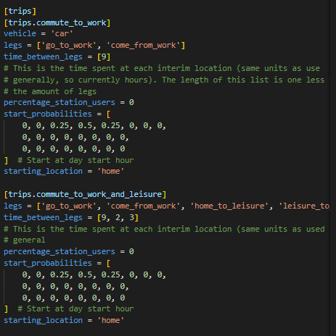
Scenario parameters
Theme name
Place text here

Slide 5
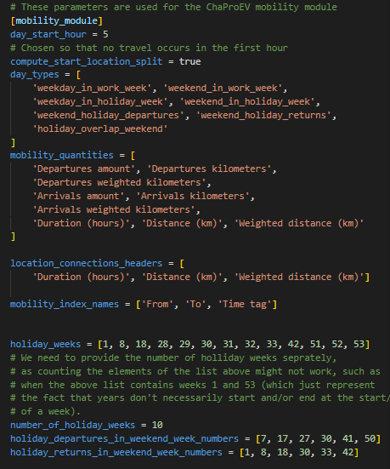
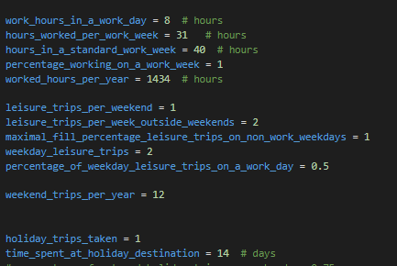
Scenario parameters
Theme name
Place text here

Slide 6
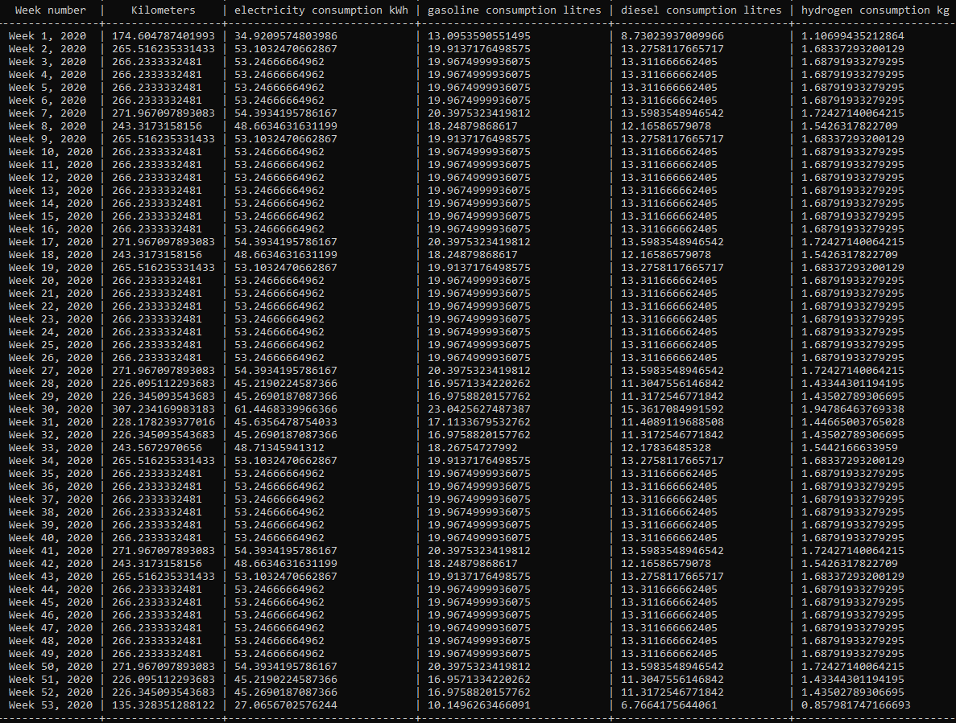
Consumption table
Theme name
Place text here

Slide 7
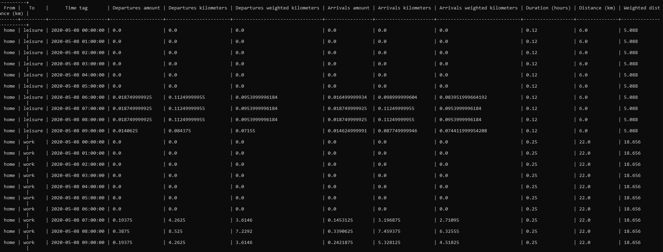
Mobility matrix
Theme name
Place text here

Slide 8
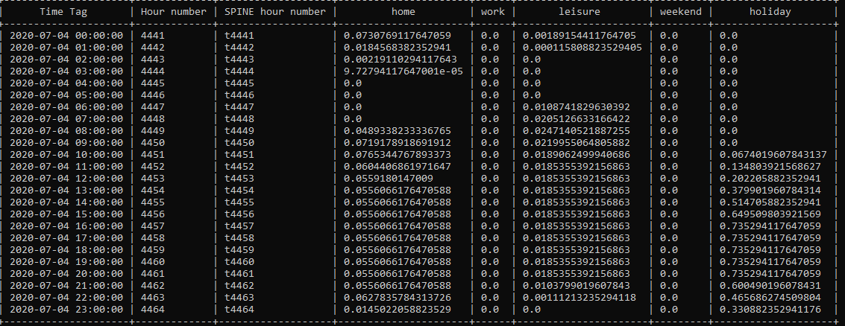
Charge from network
Theme name
Place text here

Slide 9
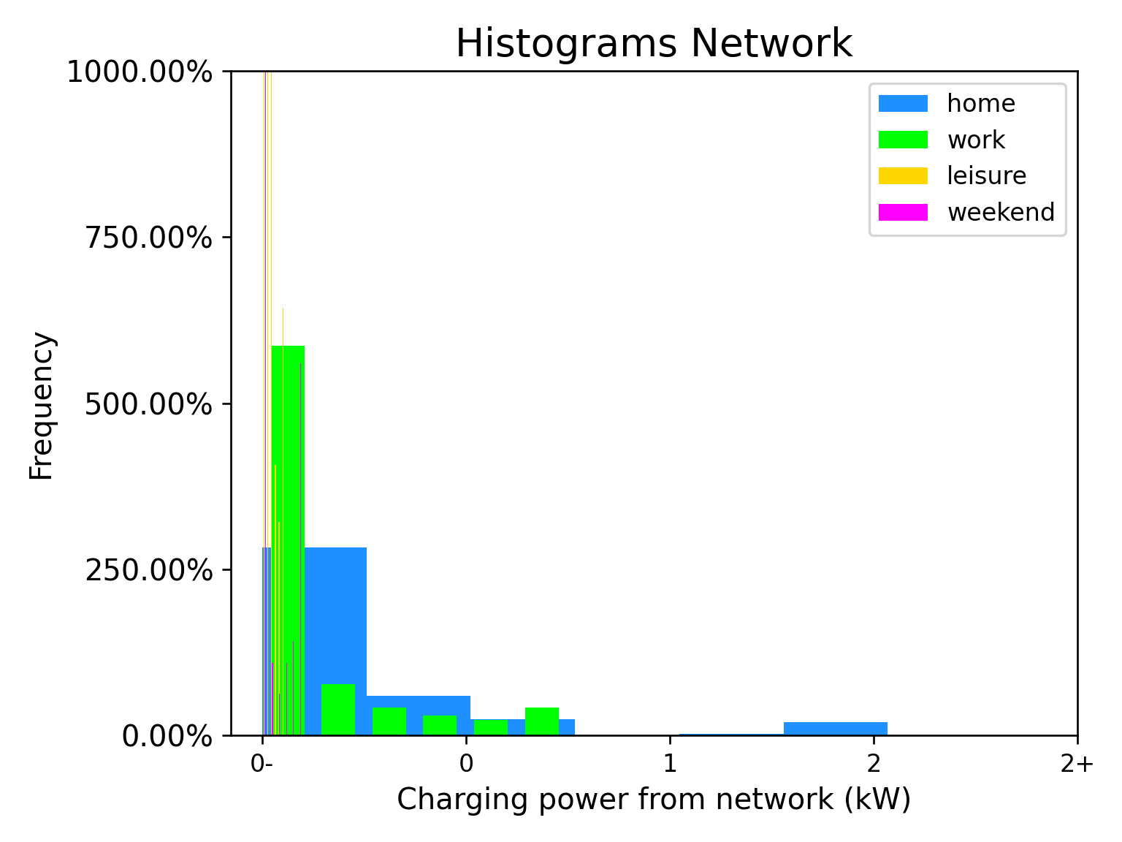
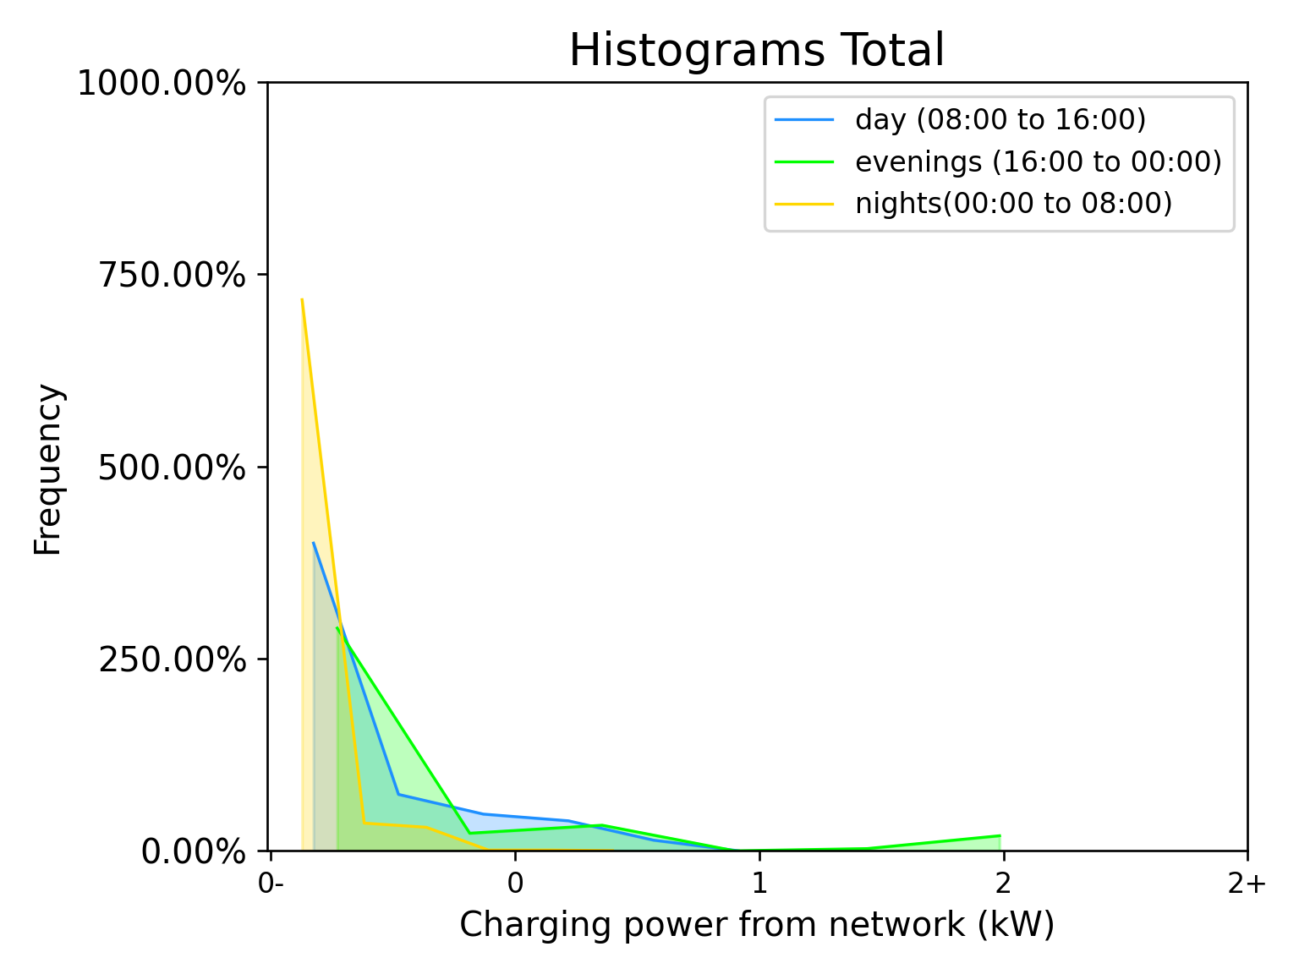
Visualize charge with histograms
Location type
Day parts

Slide 10
